Slide 1
Bibliotheca Doorway
Submitted in the partial fulfillment for the award of the degree of
BACHELOR OF ENGINEERING
IN
Computer Science Engineering (Mobile Computing)
Submitted by:
Abhigyan Prakash
(19BCS4329)
Under the Supervision of:
Madam Deepika Sharma
Department of AIT-CSE
DISCOVER . LEARN . EMPOWER

Slide 2
Outline
Introduction to Project
Problem Formulation
Objectives of the work
Methodology used
Results and Outputs
Conclusion
Future Scope
References

Slide 3
Introduction to Project
As the name suggests, it is a collection of books available on the platforms by booking it online and offline to reading it offline.
This project came into existence for having problems like: -
Unavailability of seats
Long Procedures of registrations.
Long queues.

Slide 4
Introduction to Project
The project predominantly aims to provide registration on both the platforms i.e. Online and Offline.
Additionally, reduced bloatware helps the user to navigate through without an aid of any second person.
Navigation made easy!!
(Nonetheless Administrators be always available to encourage the queries)

Slide 5
Problem Formulation
This Project came into existence because of following reasons: -
Online Booking
Mapping of the service
Manage you dues
Hazzle-free registration

Slide 6
Problem Formulation
Few more stress-free areas like: -
Seat reservation
Time Slots
Fatigue-free queues

Slide 7
Objectives
We’ve have come across to solve and highlight the features.
Hazzle free booking.
No more waiting is long queues.
Real-time seat reservation.
Mapping of service.
Time Management.

Slide 8
Methodology used
The methodology employed in the course of the project are outlined as follows: -
Outline a set of requirements to be met by the system proposed.
Conceive and implement the design of the said system as a GUI java based application.

Slide 9
Methodology used
Development of the solution system using java.net, Swing in line with IDE and applications.
Detailed reporting of the findings stated above, with deduced inferences, and noted grounds for future innovation.

Slide 10
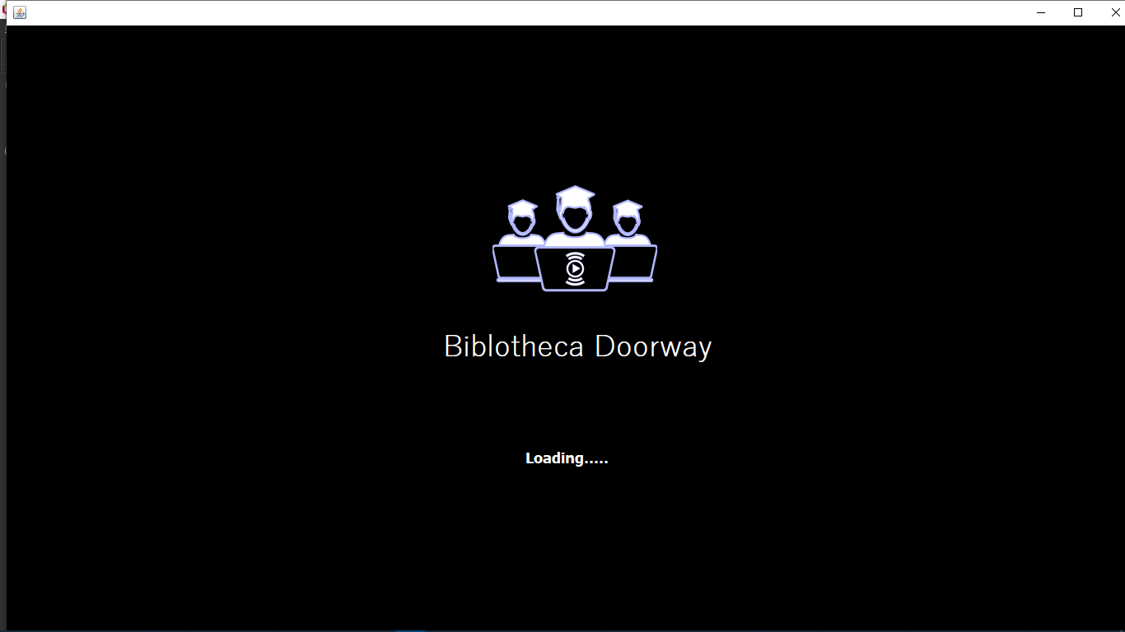
Results and Outputs

Slide 11
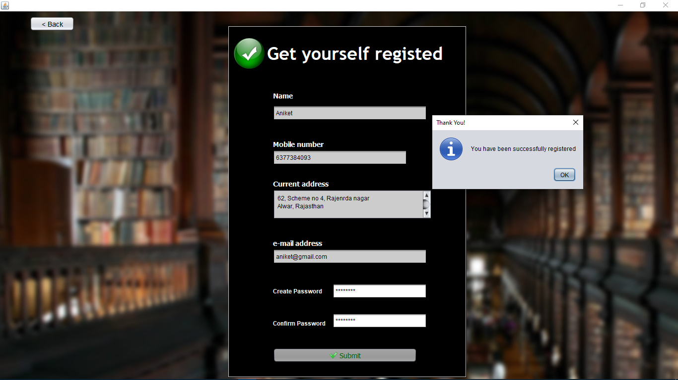
Results and Outputs

Slide 12
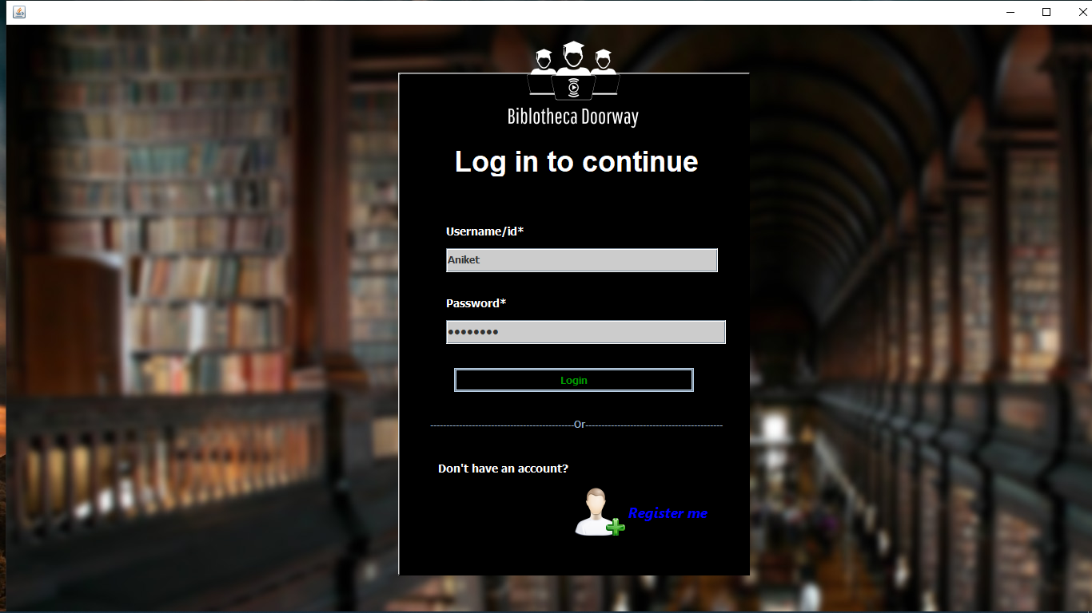
Results and Outputs

Slide 13
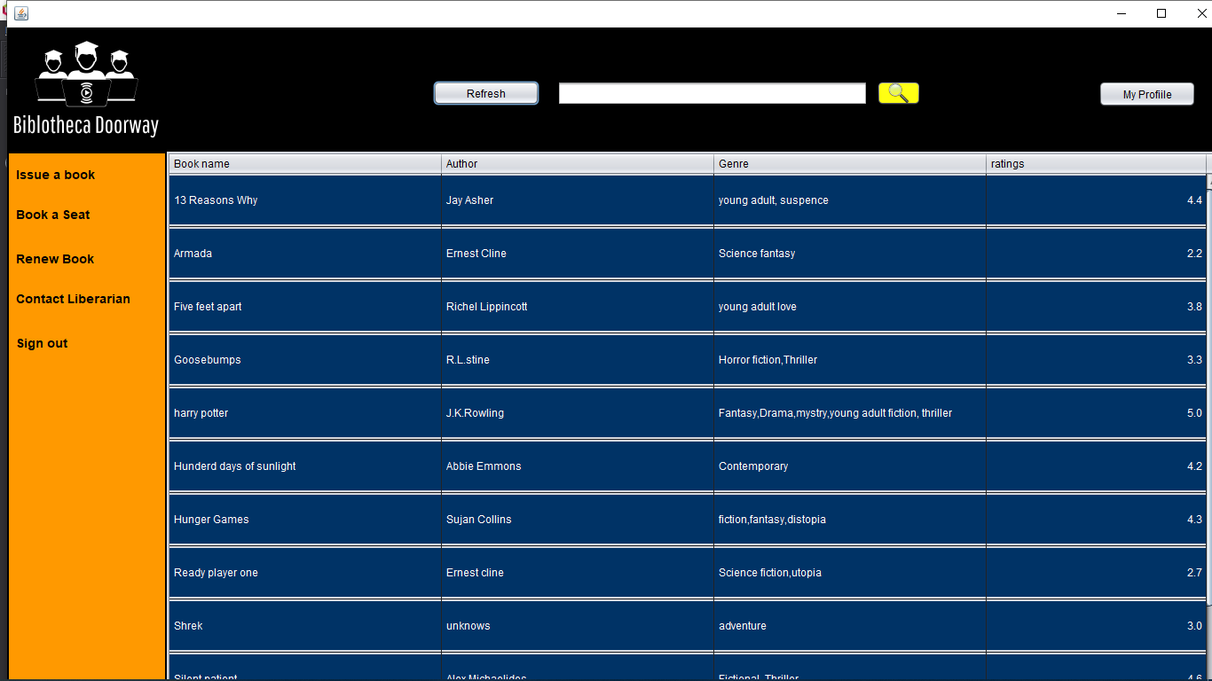
Results and Outputs

Slide 14
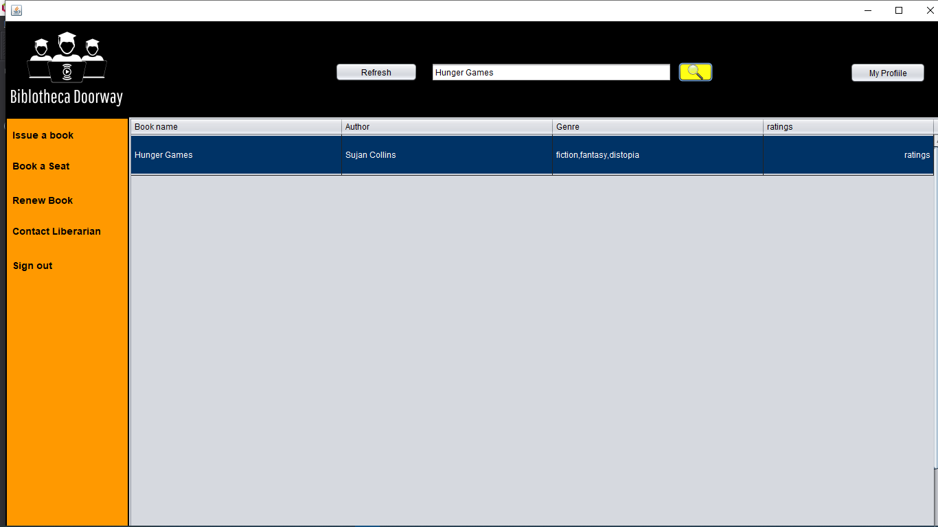
Results and Outputs

Slide 15
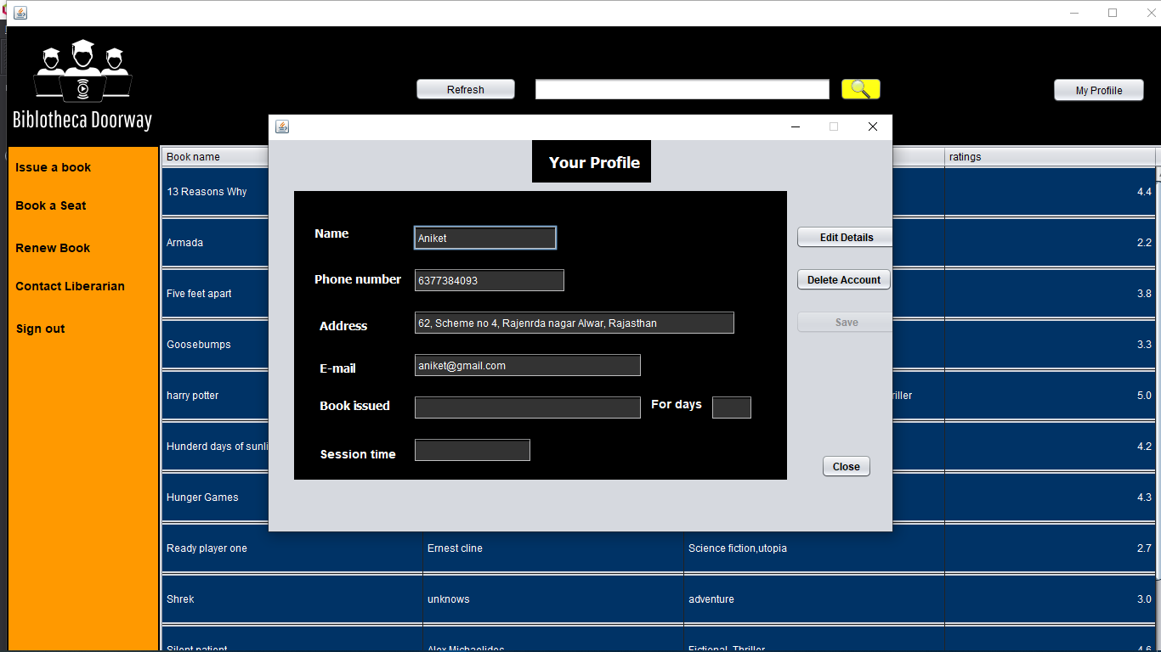
Results and Outputs

Slide 16
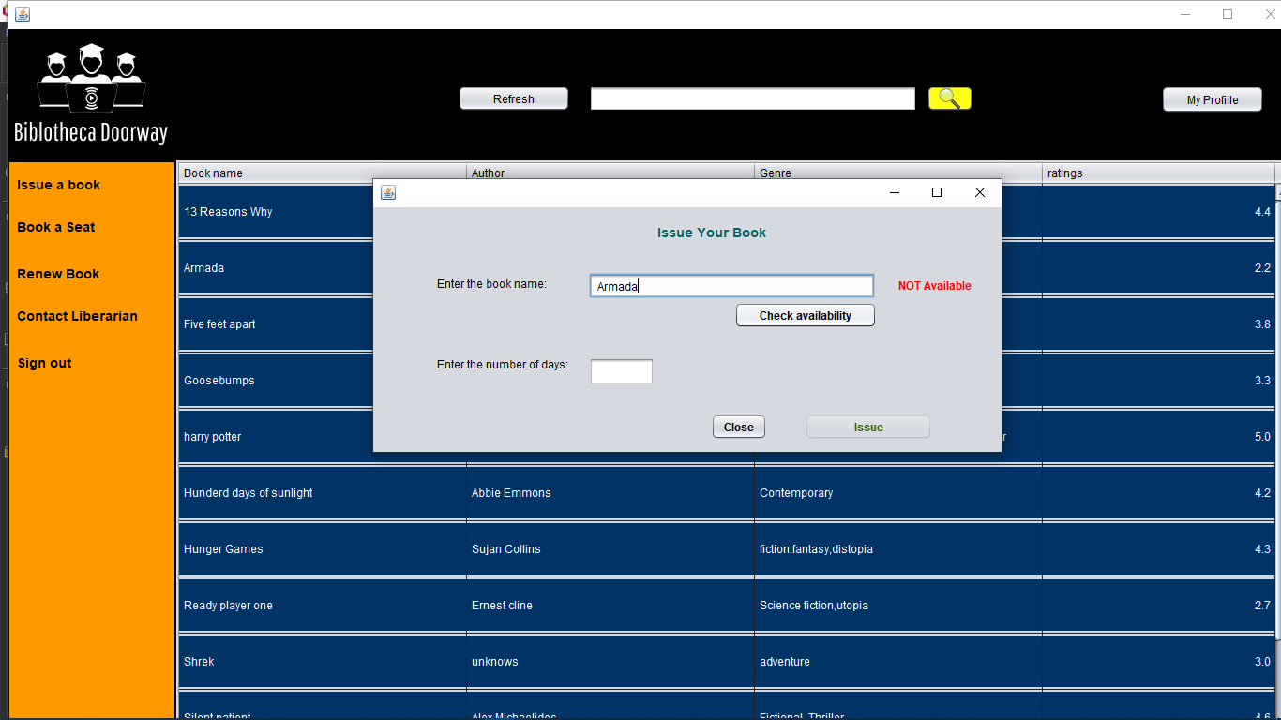
Results and Outputs

Slide 17
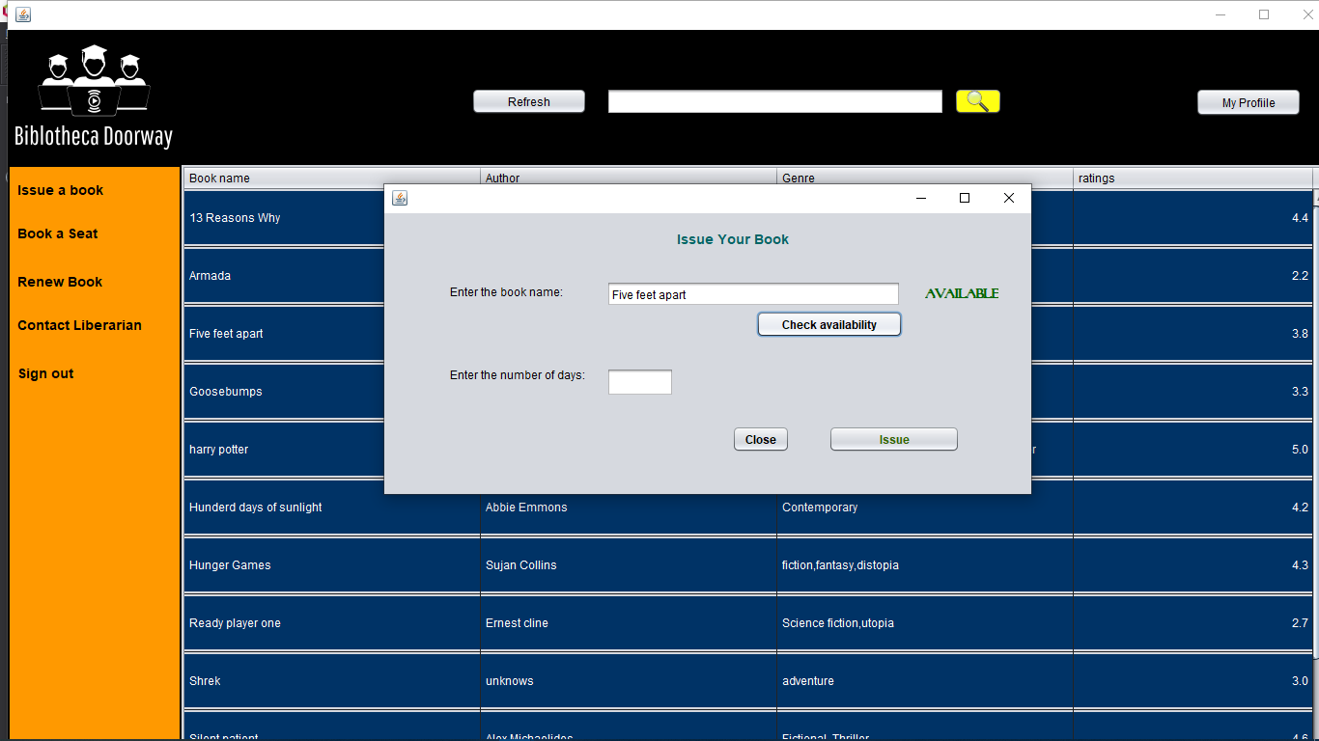
Results and Outputs

Slide 18
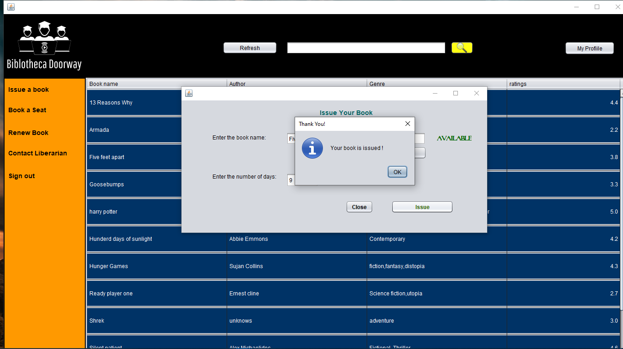
Results and Outputs

Slide 19
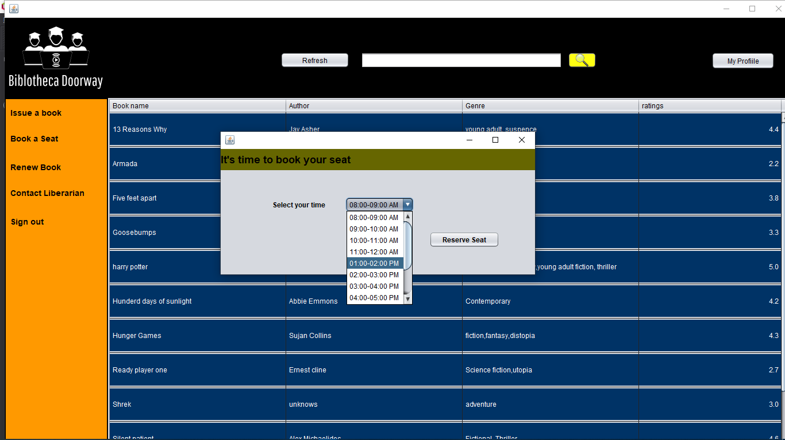
Results and Outputs

Slide 20
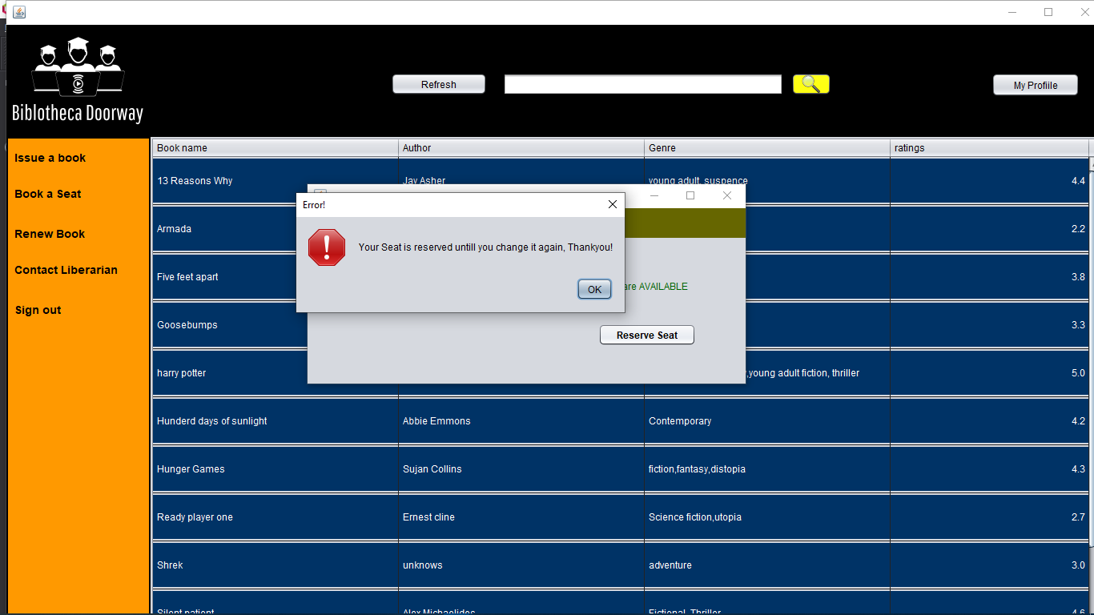
Results and Outputs

Slide 21
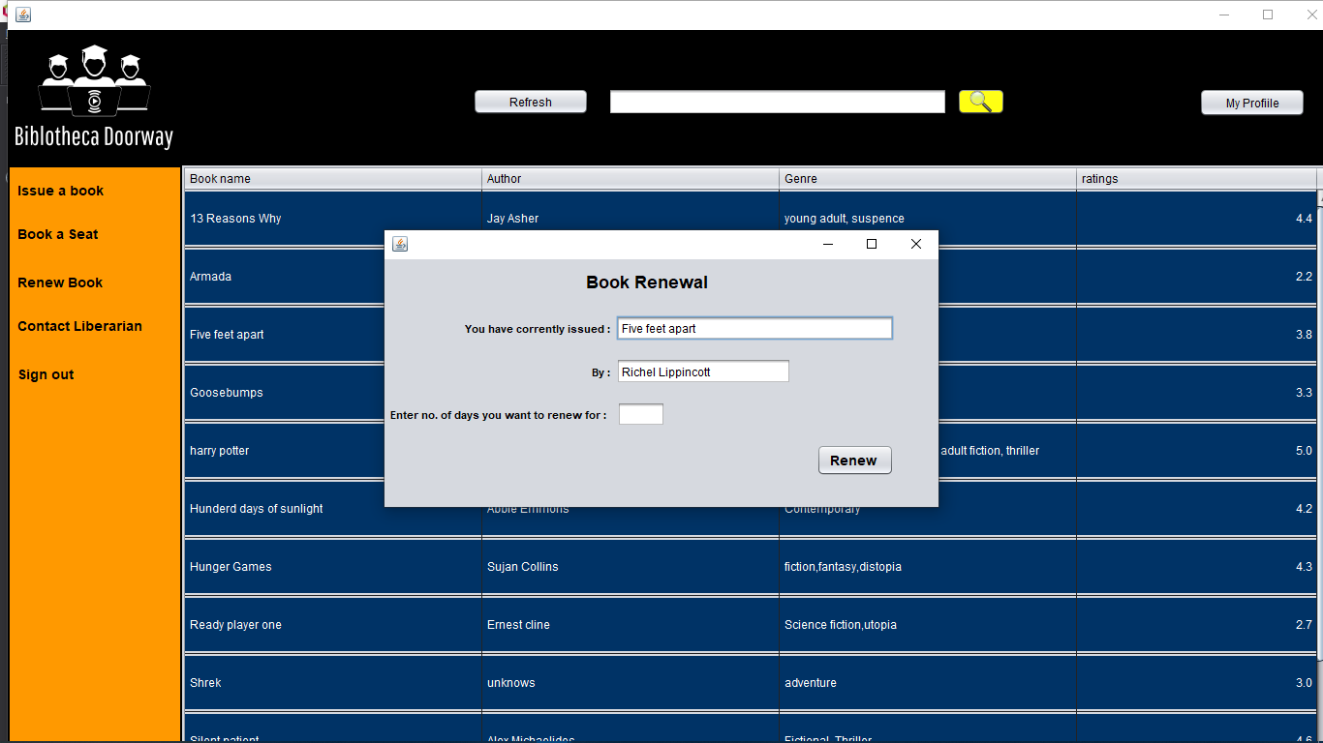
Results and Outputs

Slide 22
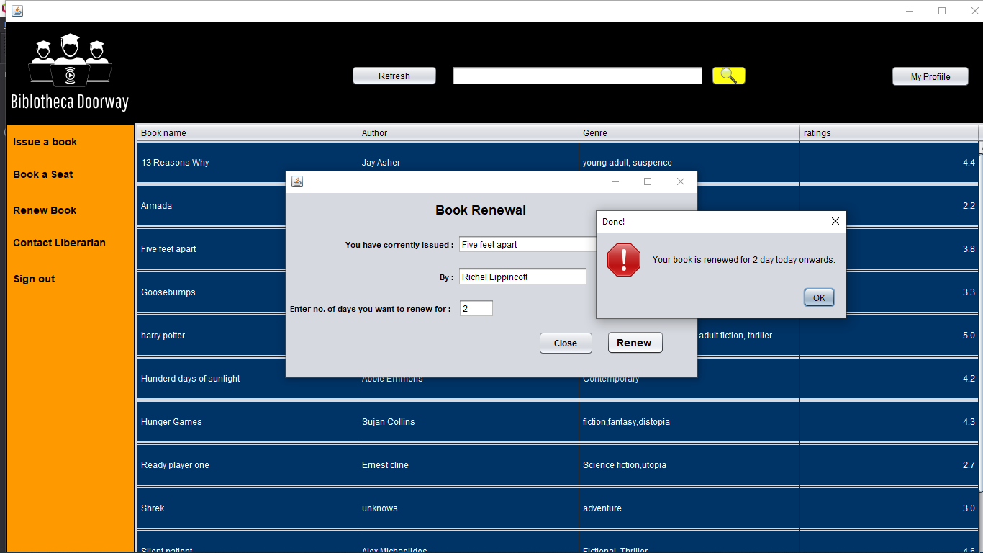
Results and Outputs

Slide 23
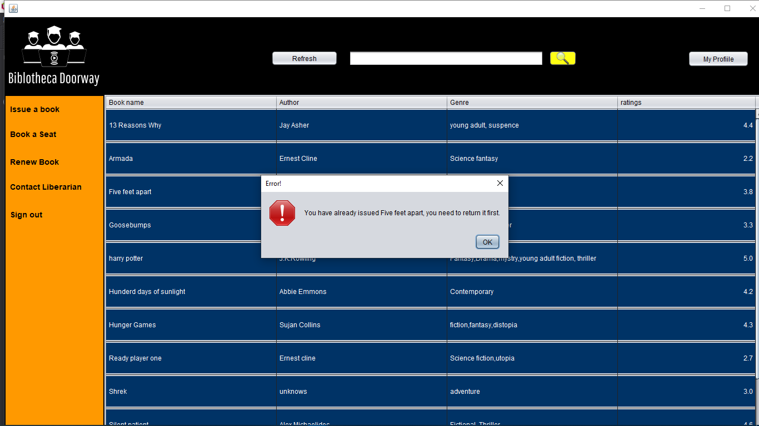
Results and Outputs

Slide 24

Results and Outputs

Slide 25
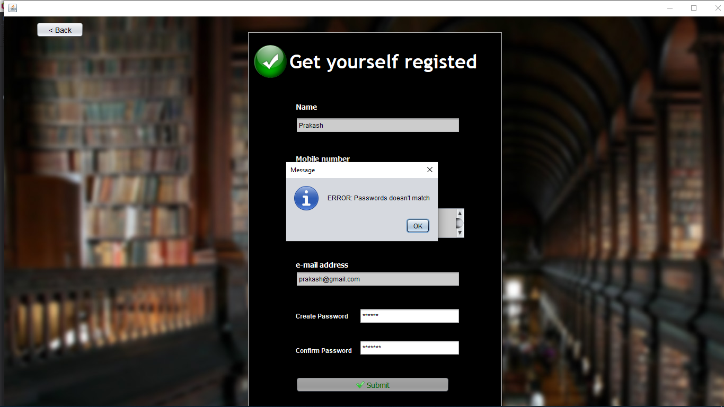
Results and Outputs

Slide 26
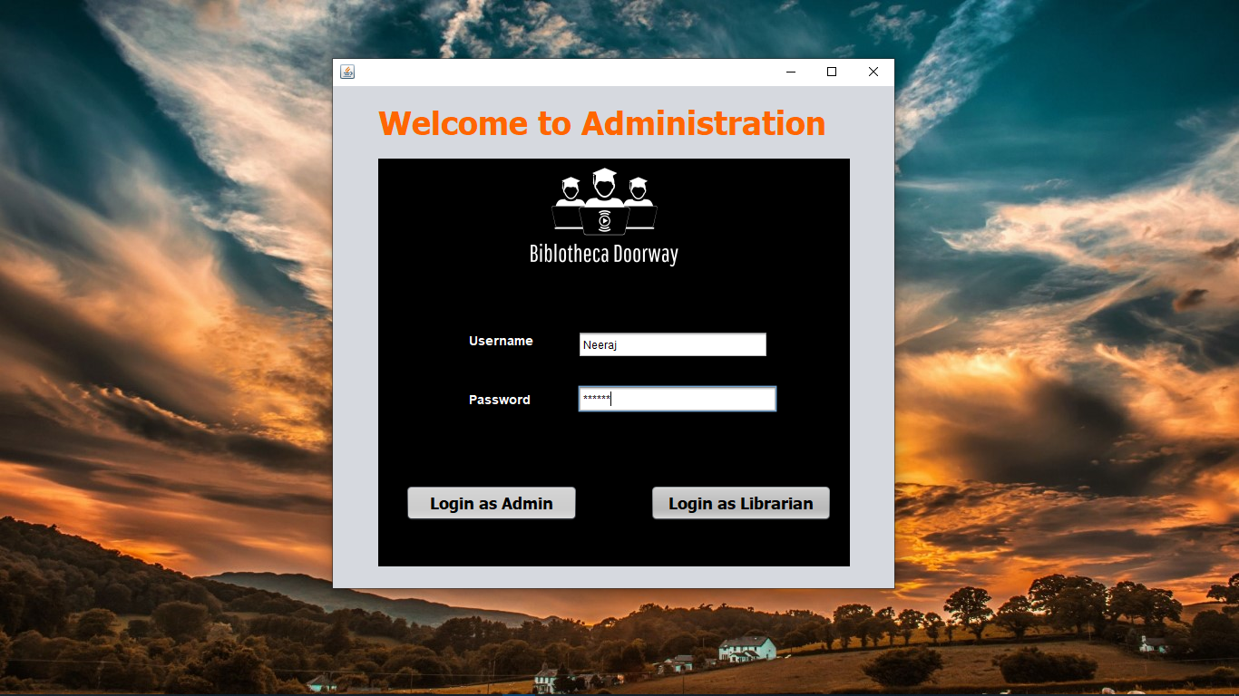
Results and Outputs

Slide 27
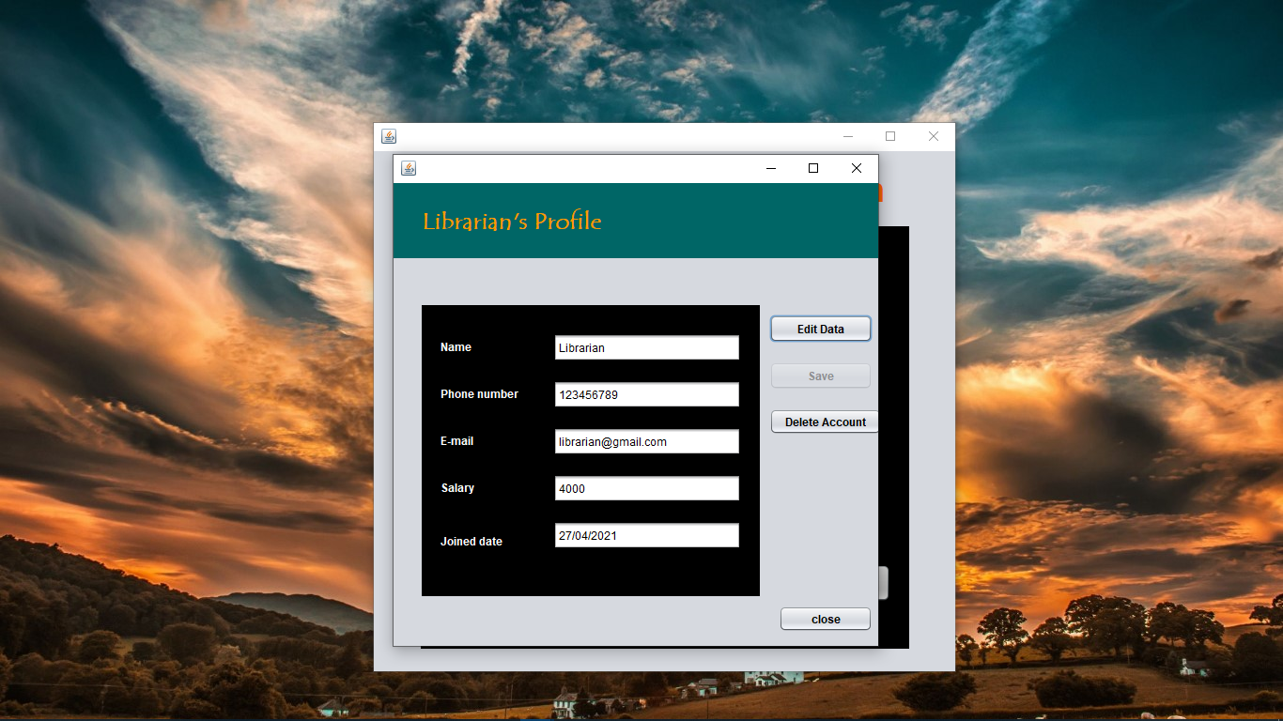
Results and Outputs

Slide 28
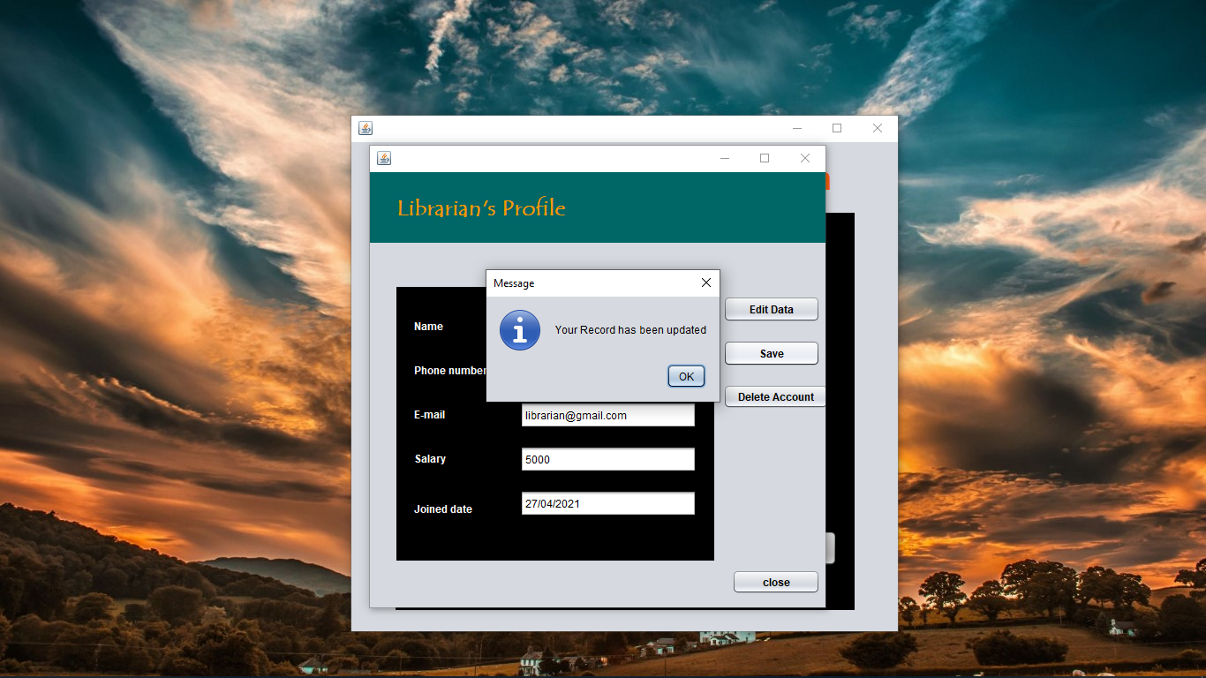
Results and Outputs

Slide 29
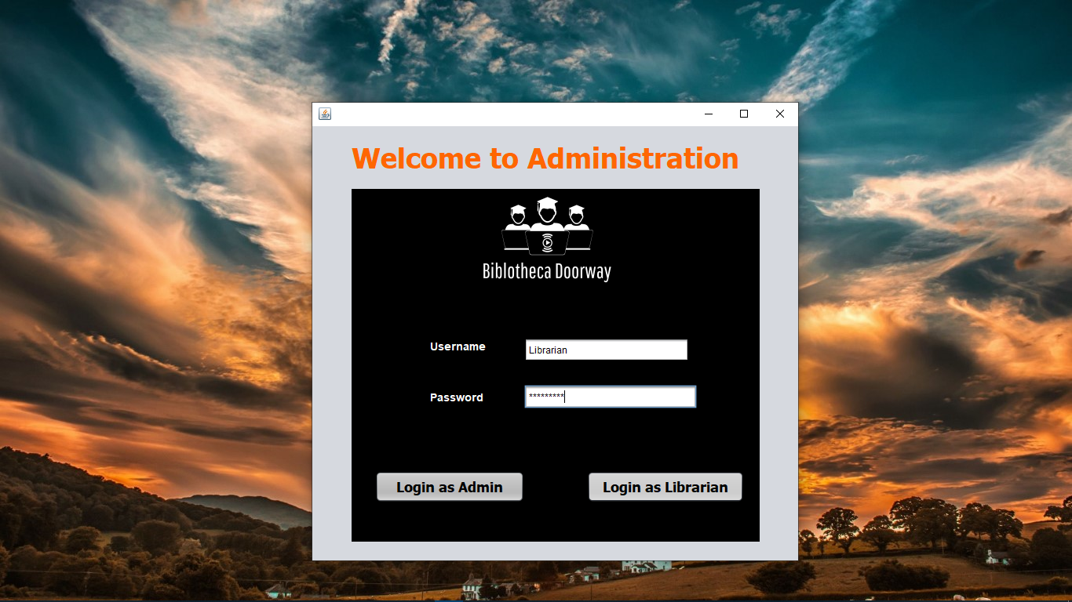
Results and Outputs

Slide 30
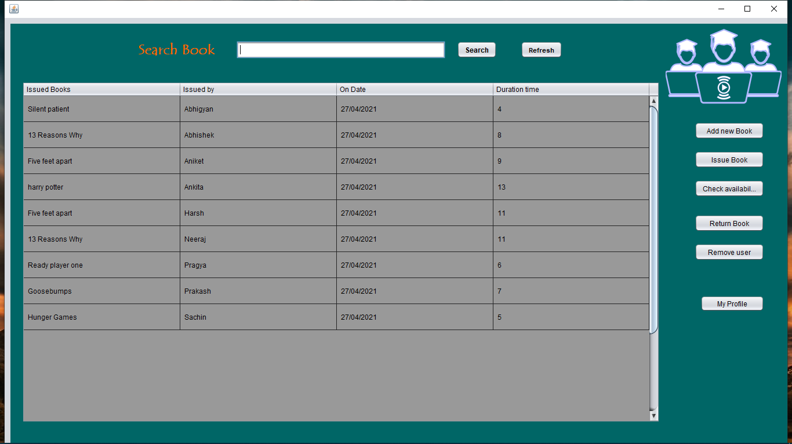
Results and Outputs

Slide 31
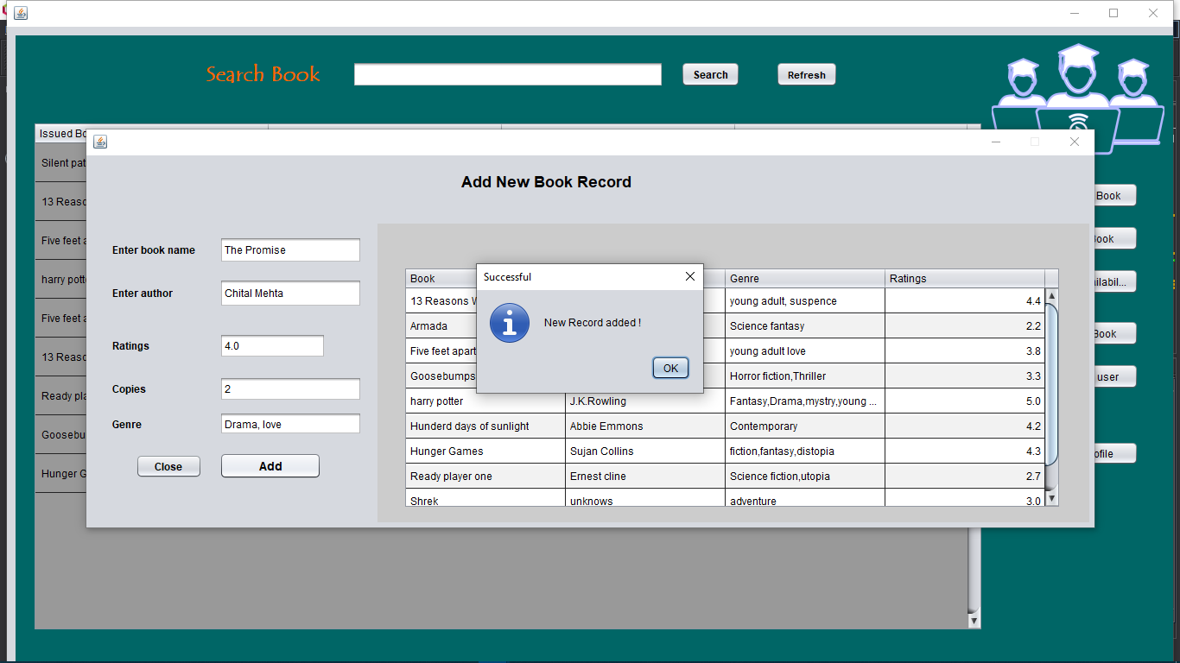
Results and Outputs

Slide 32
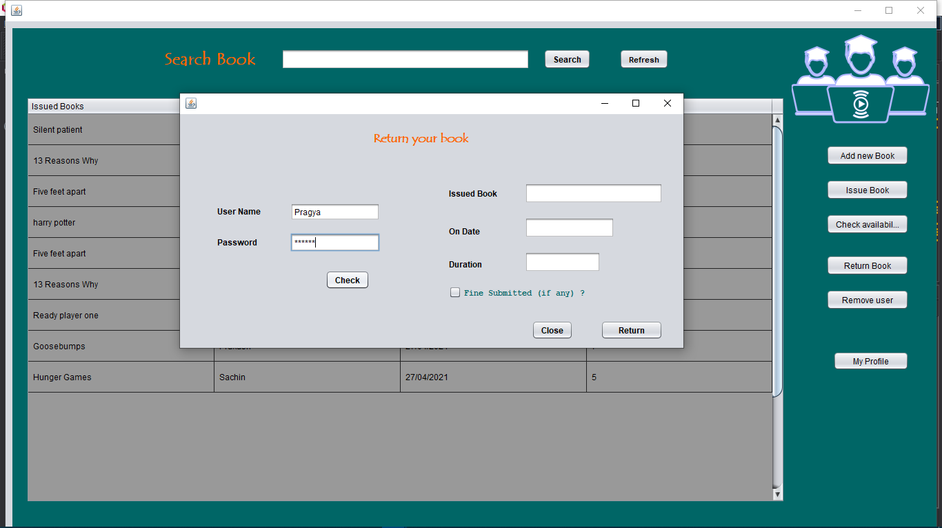
Results and Outputs

Slide 33

Results and Outputs

Slide 34
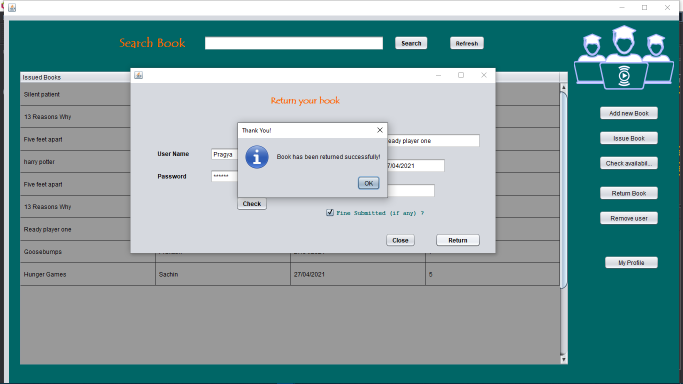
Results and Outputs

Slide 35
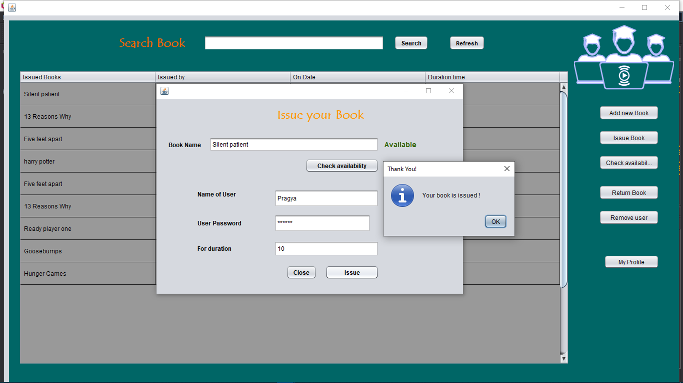
Results and Outputs

Slide 36
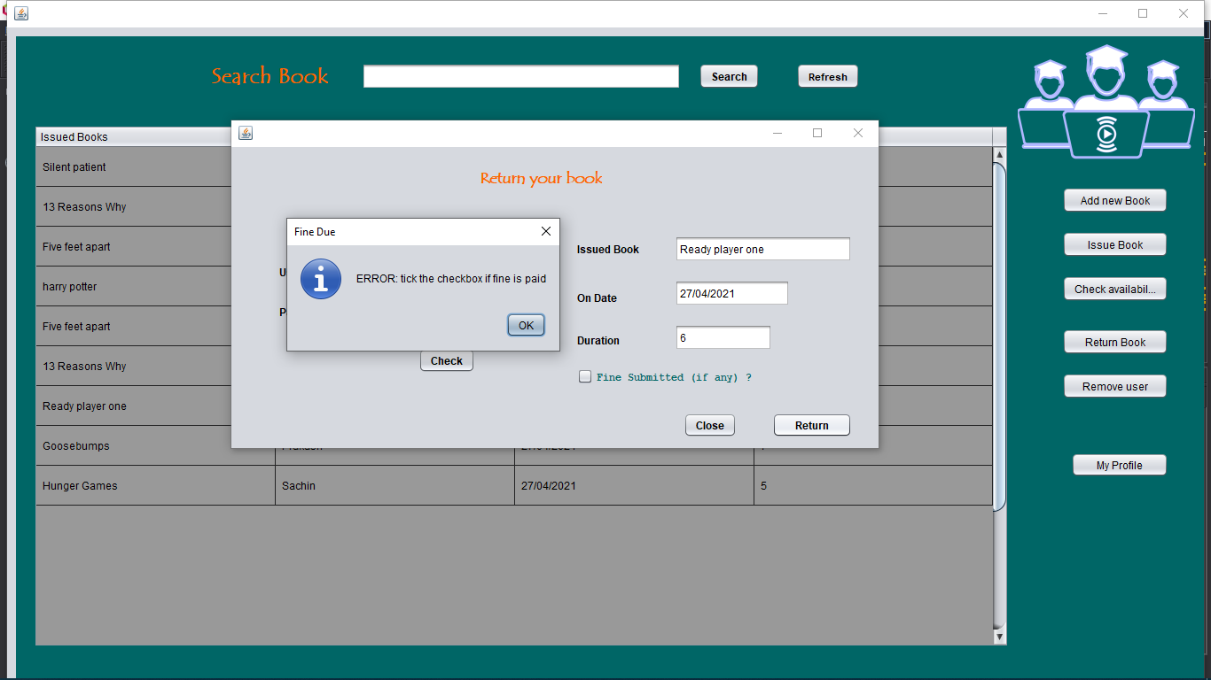
Results and Outputs

Slide 37
Conclusion
The existing Library Management System was limited by few limitations and with our proposed system we would be able to accomplish all the pitfalls of an ordinary LMS.

Slide 38
Future Scope
With an upgradation to Remote server, We would be able to use this is on different peripheral devices over different Network.
Having an access to add books to your Wishlist.
Opening gateways to “Forgotten Passwords”

Slide 39
References
Programming With Java by E Balagurusamy (4th edition)
For Database: -
https://www.w3schools.com/sql/
https://www.tutorialspoint.com/sql/index.htm
https://www.youtube.com/watch?v=BPHAr4QGGVE&t=11969s
For Frames: -
https://www.youtube.com/watch?v=XvkpB9ntDoA
https://www.youtube.com/watch?v=Yw0p7tTFAoc

Slide 40
References
For Java: -
https://www.youtube.com/watch?v=5kOnw0vRaSY
https://www.javatpoint.com/java-swing
https://alvinalexander.com/java/java-jframe-background-color/#:~:text=In%20general%2C%20to%20set%20the,RED)%3B
For Java and Database(JDBC)
https://www.youtube.com/watch?v=F4vpJJH2PZU&t=6s

